Slide 1
Lecture 10: Double and Iterated Integrals Over Rectangles
Abigail Rose Lindner
MA 1024 Calculus IV
Summer 2024 - E2 Term

Slide 2
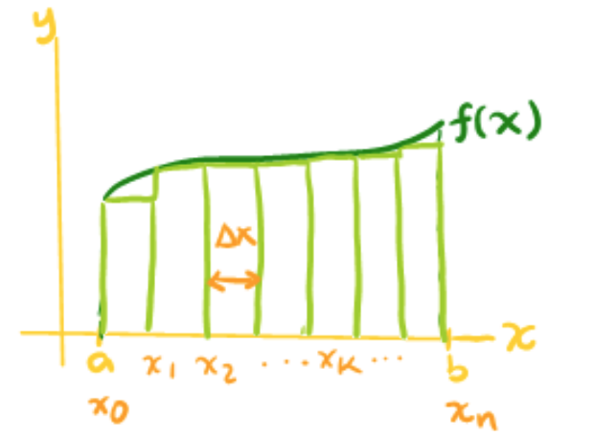
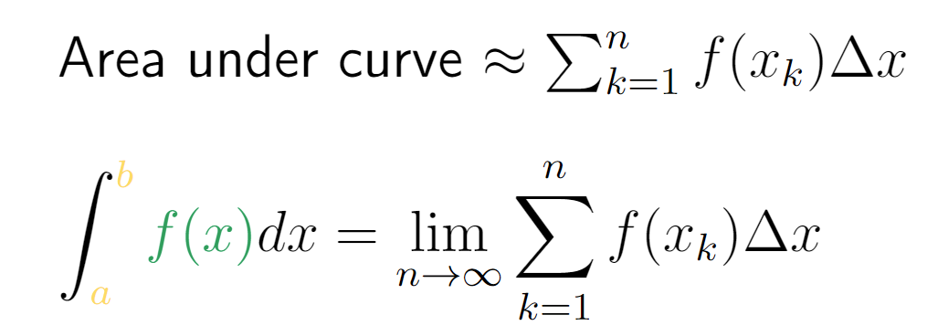
Review from previous calculus courses
InIn
In single-variable calculus, definite integrals gave the area between a curve and the x-axis.
Fundamental Theorem of Calculus

Slide 3
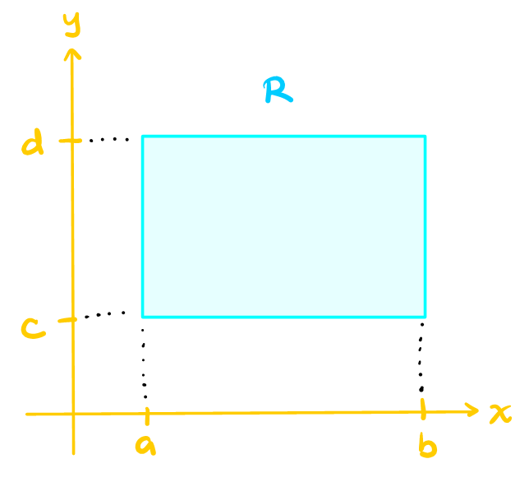
Definition/Interpretation
InIn
Let us start with the simplest region, a rectangle.

Slide 4
We start with a nice rectangular region in the xy-plane.

Slide 5
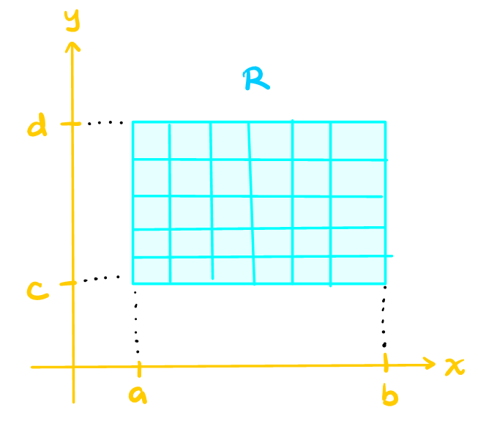
We partition this region into small, rectangular pieces.

Slide 6
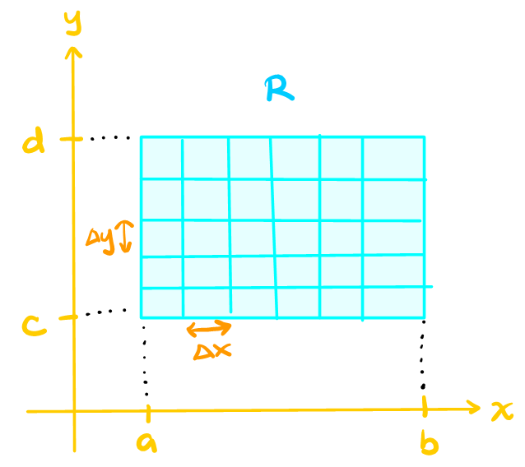
We have a horizontal distance Δx and a vertical distance Δy between the rectangular pieces.

Slide 7
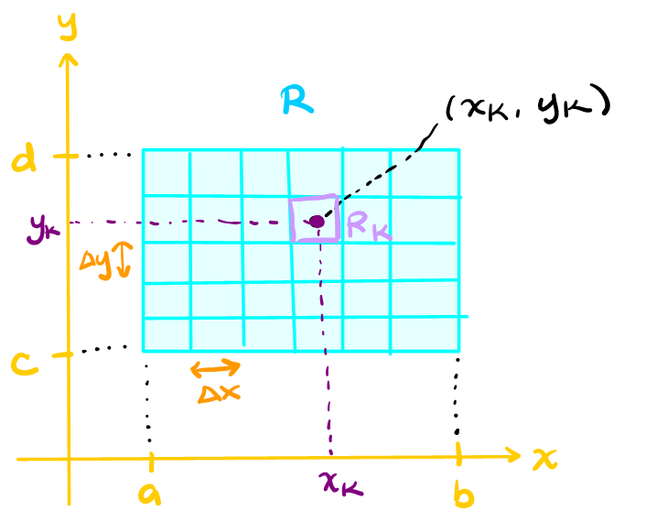
We pick a point within each rectangular piece to evaluate during our upcoming approximations.

Slide 8
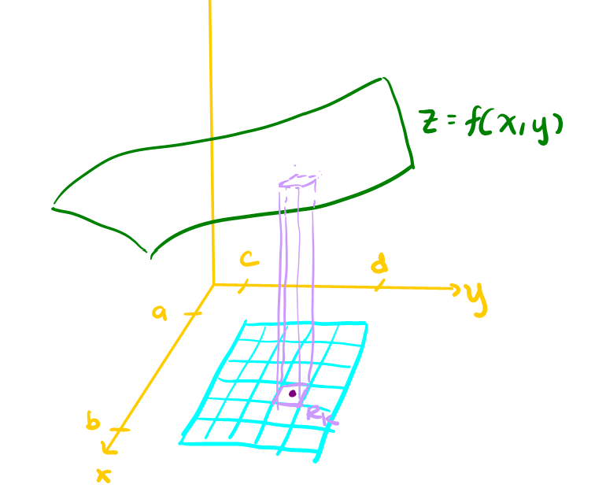
Using this partitioning of the region R, we approximate the volume under the graph with rectangular columns.

Slide 9
Definition

Slide 10
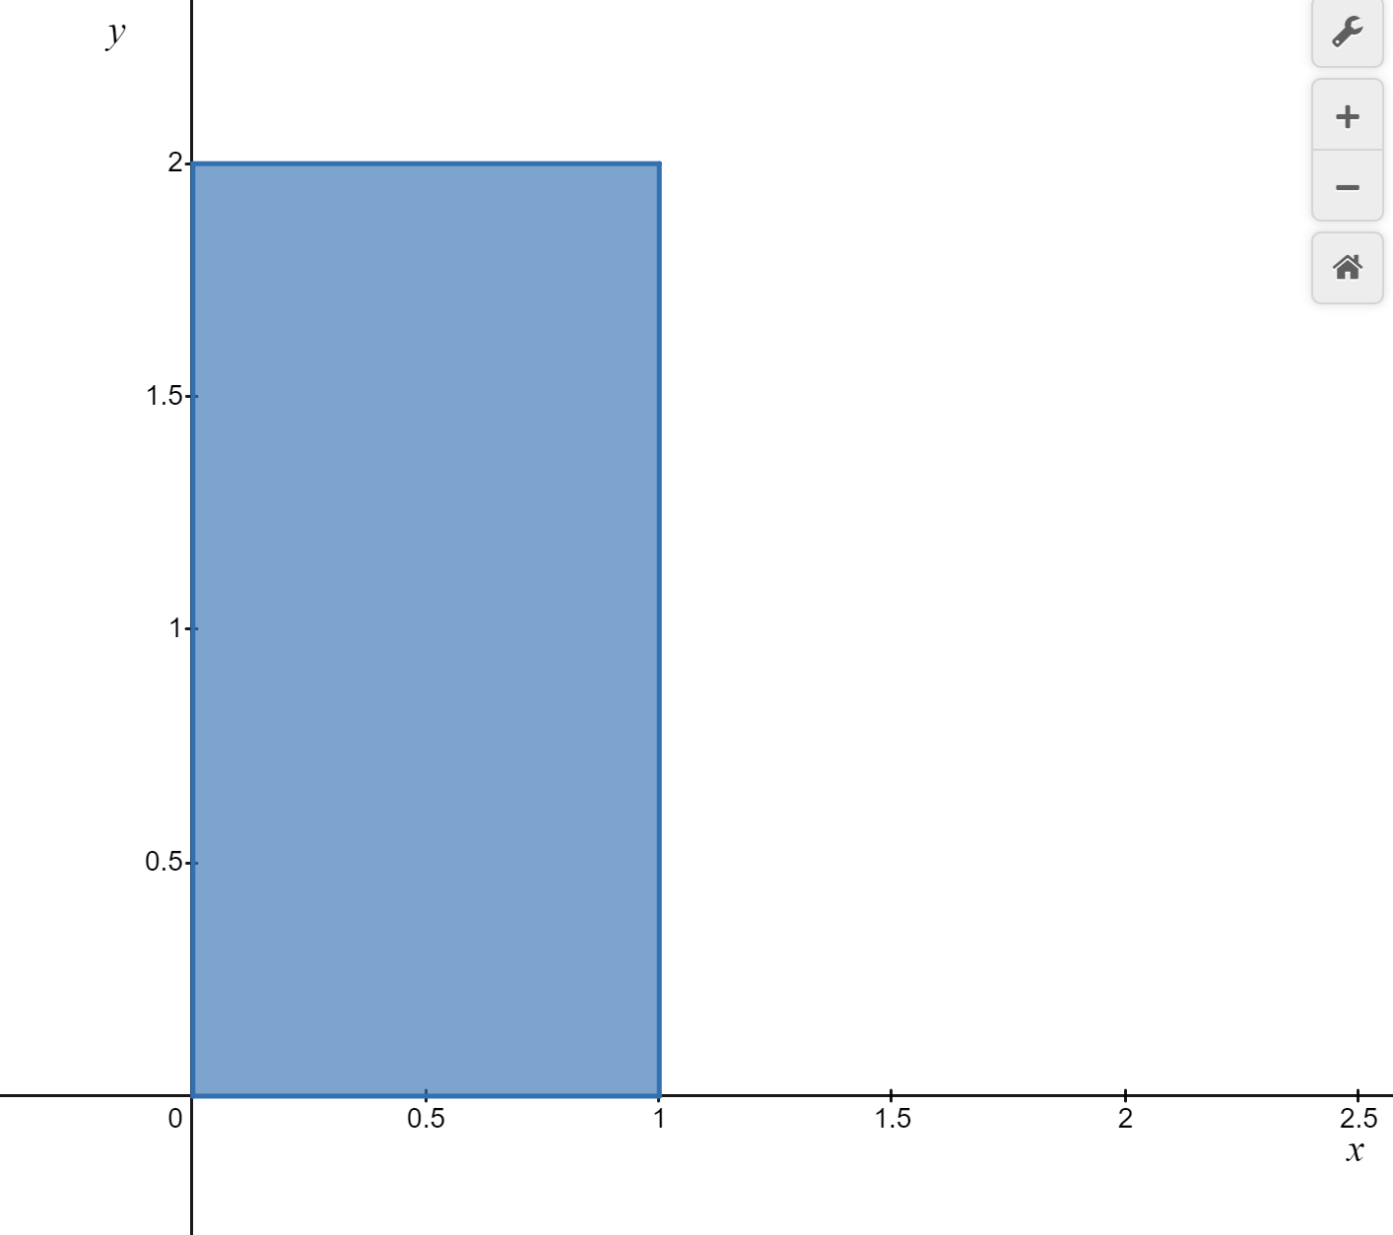
Example

Slide 11
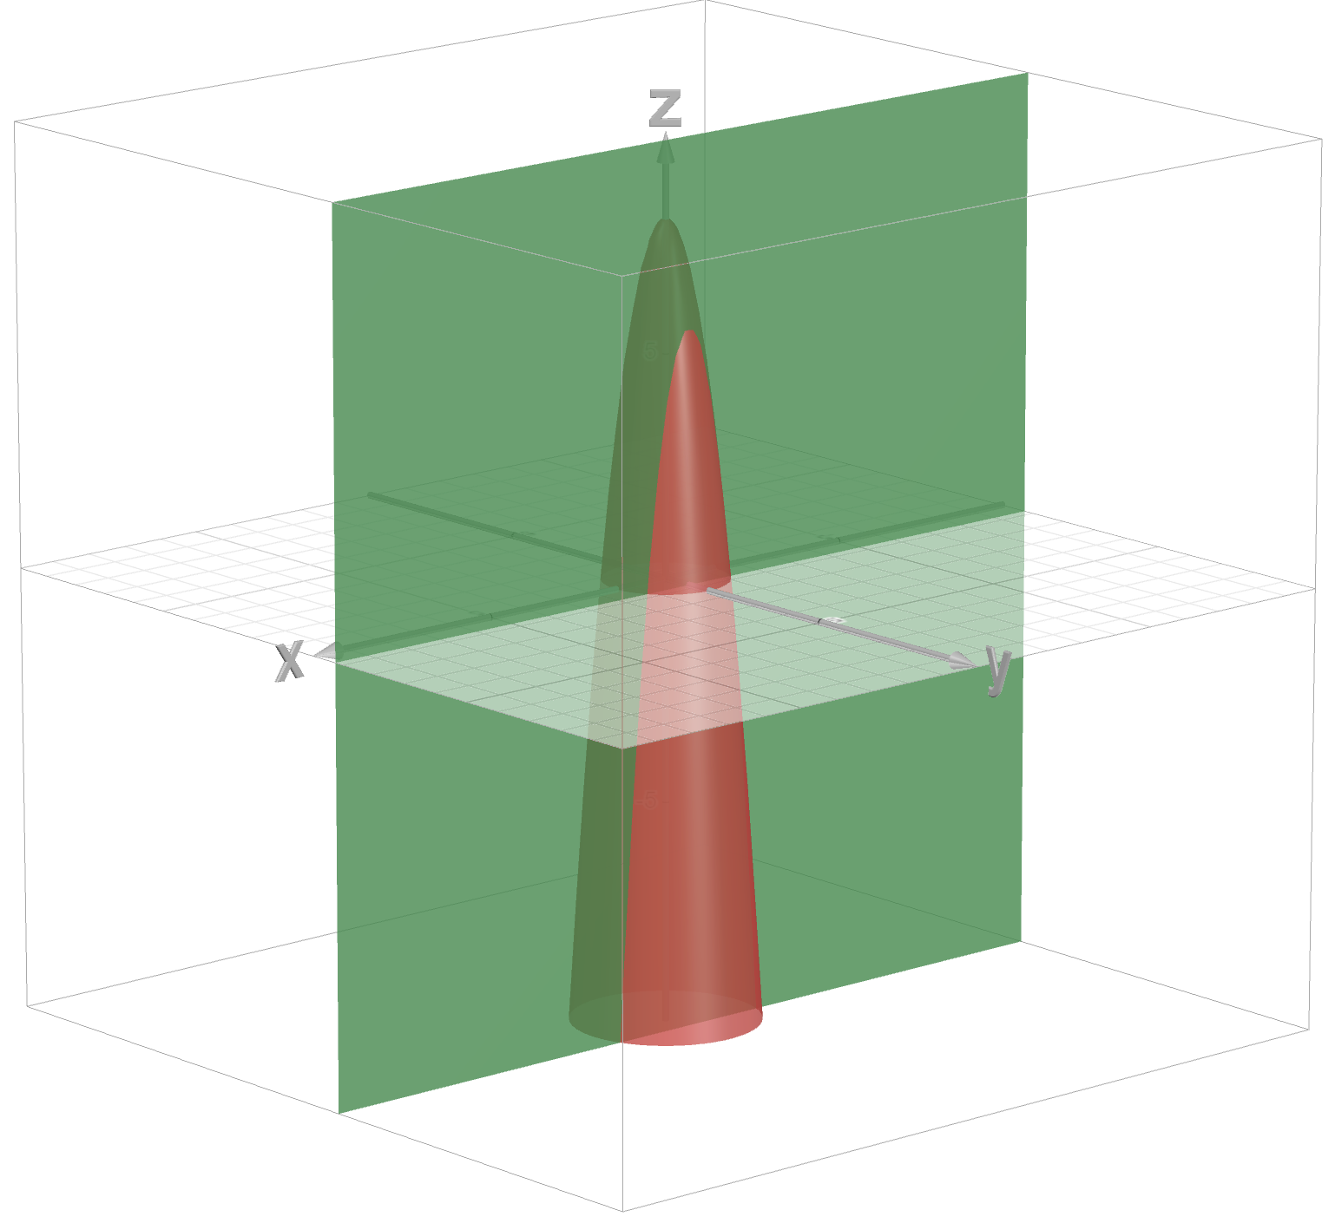
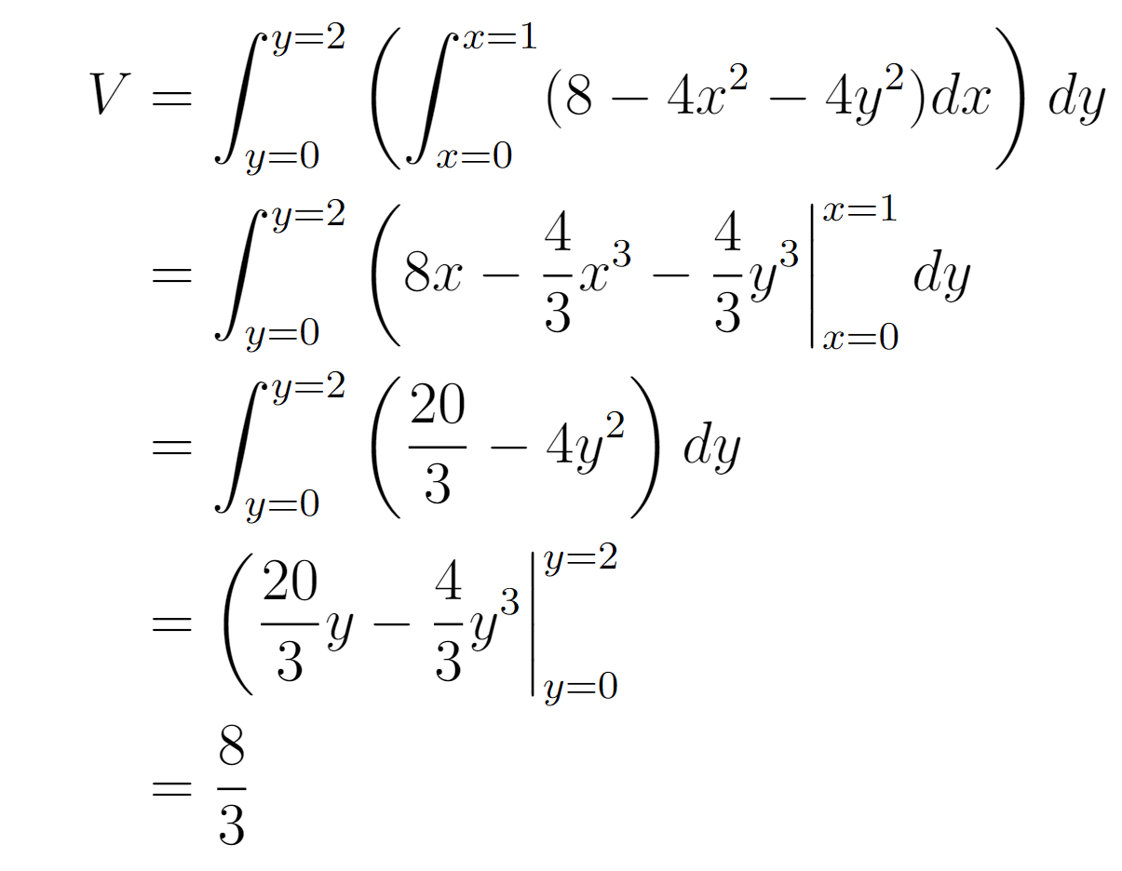
Example
—
Summing over the y:

Slide 12
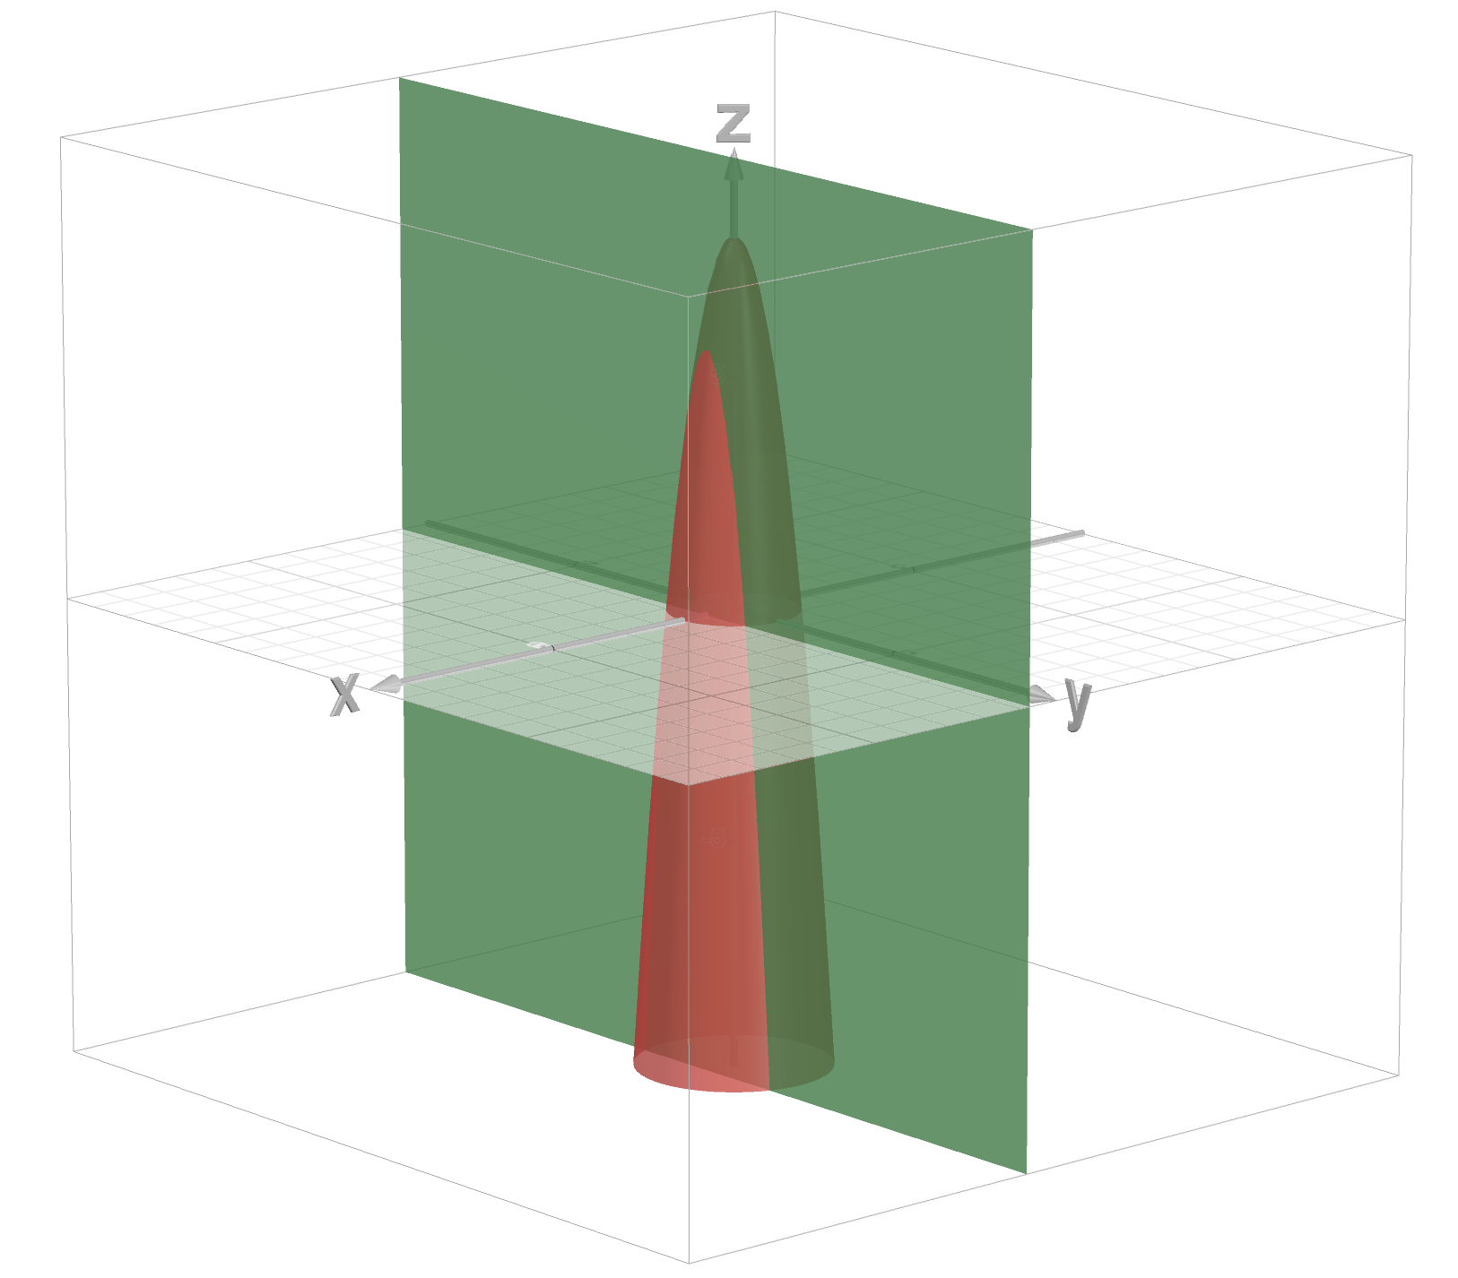
Example
—
Summing over the x:

Slide 13
Fubini's Theorem
Notes
Double integrals can be evaluated using iterated integrals.
We can integrate, given certain nice conditions, in either order. This is useful if one order happens to be algebraically easier than the other.
Notation

Slide 14
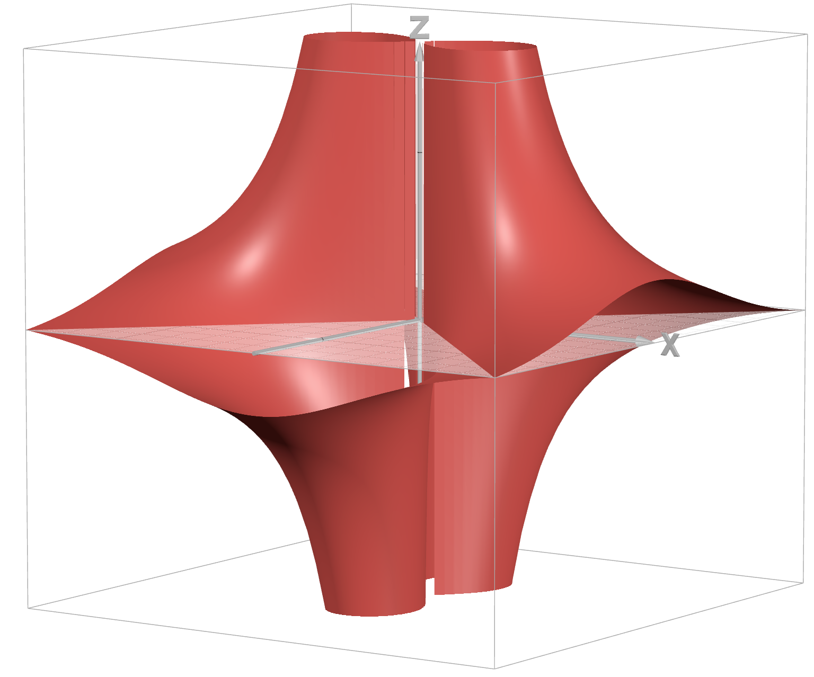
Bonus:

Slide 15
Upcoming...
Double and iterated integrals over general regions

